Slide 1
Deep Learning
References - > Linked in and Udemy Course

Slide 2
Artificial Neural Network
Udemy

Slide 3
Activation Function Forms
4 types (Predominant ones)
1. Threshold function -> if the value is less than 0 the threshold function passes 0 and if more than or equal to zero then 1 is passed
2. Sigmoid function -> (1)/(1+e^-x) -> Used in logistic regression. It is a smooth curve. Sigmoid function is very useful in final layer especially when we are trying to predict probabilities/outcome
3. Rectifier function -> max(x,0)
4. Hyperbolic Tangent function -> {1-(e^-2x)}/{1+(e^-2x)}. Value goes from -1 to +1

Slide 4
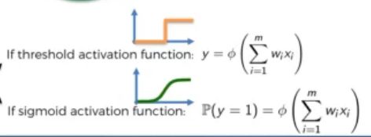
Graphs :

Slide 5
A common combination :
In the hidden layer we apply the rectifier function and at the output we apply the sigmoid function
Neural networks :
Example : we provide the images of dogs and cats and let the neural network understand the difference between them
Perceptron

Slide 6
Cost function tells us the error. They are many ways to calculate cost function.
Lesser the cost function more accurate our output
One epoch is when we go through the whole dataset and we train our neural network on all of these rows
Adjusting the weights again and again to minimize the cost function, this process is called back propagation
Curse of Dimensionality

Slide 7

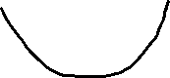
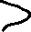
Gradient Descent
Faster way to find the best option
If the slope is negative go downhill and if positive go uphill
Requires the cost function to be convex (one global minimum)
-> Stochastic Gradient descent : Doesn’t require for the cost function to be convex
Normal gradient descent -> when we take all of our rows and plug them into our neural network and then we calculate the cost function and based on the cost function value we adjust the weights
-> Stochastic neural network -> here we take one row, run our neural network and then we adjust the weights, then we move on to the second row ……. . It is faster than gradient descent method. This is a deterministic method

Slide 8
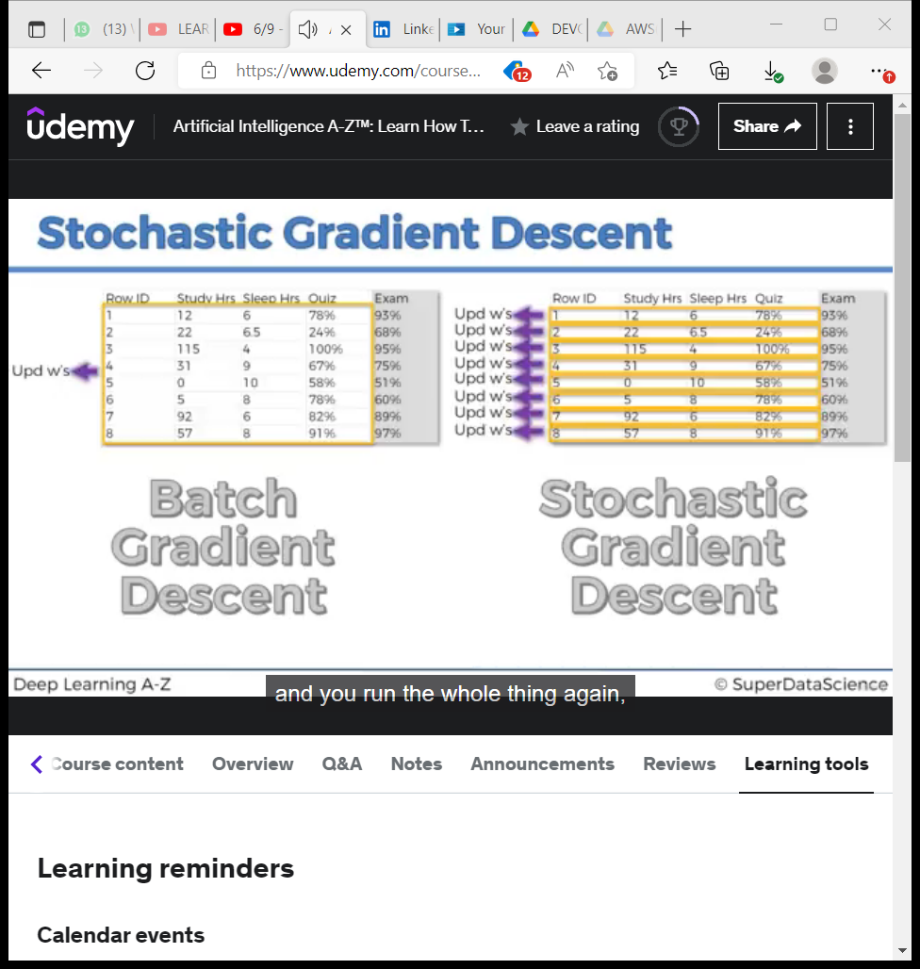
Difference

Slide 9
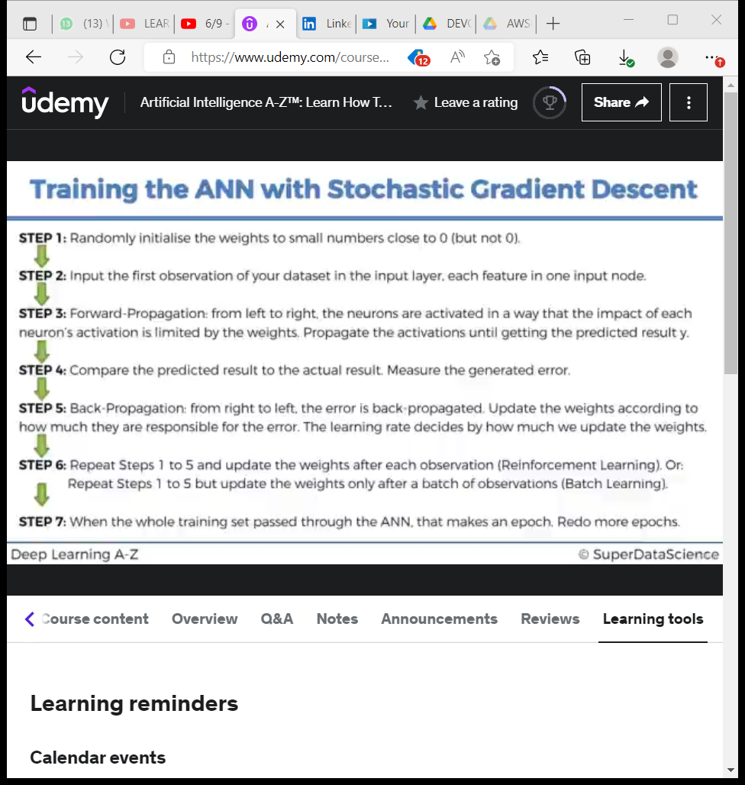
Back propagation allows us to adjust all the weights at the same time

Slide 10
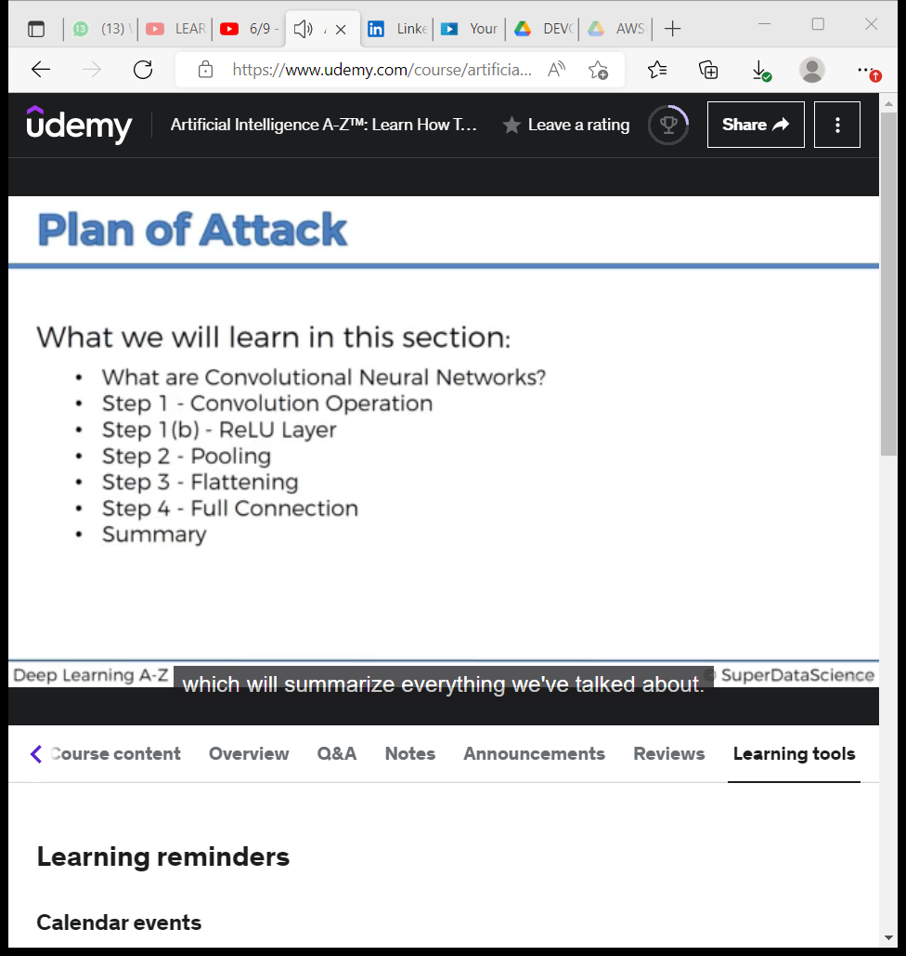
Convolutional Neural Network (CNN)

Slide 11
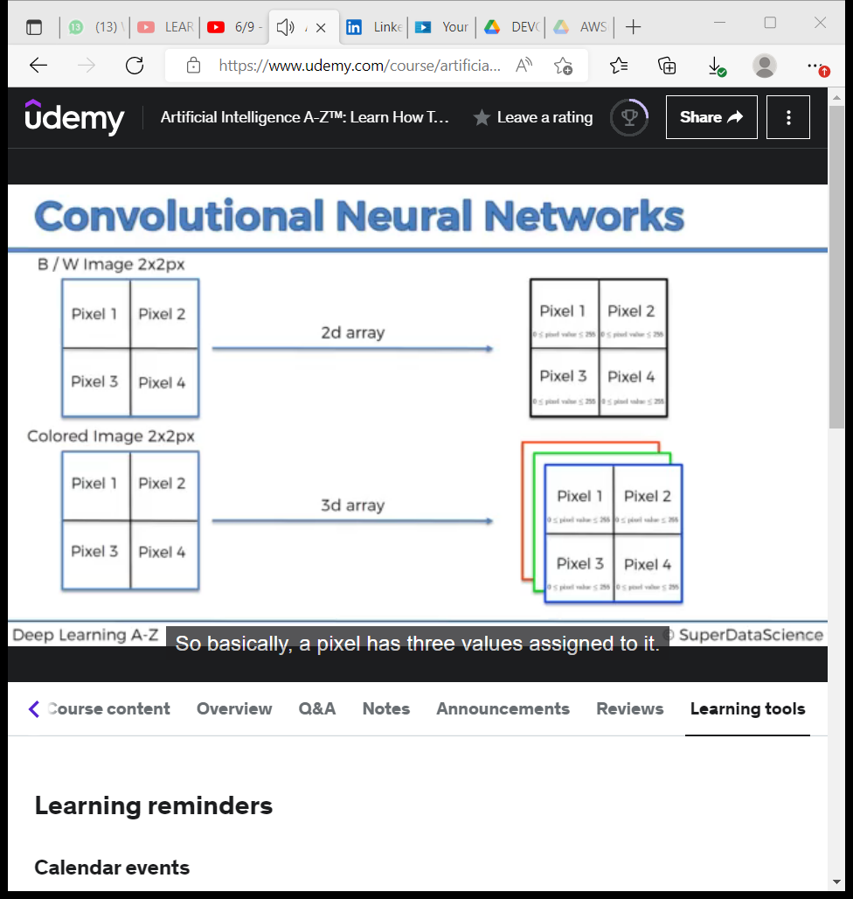

Slide 12
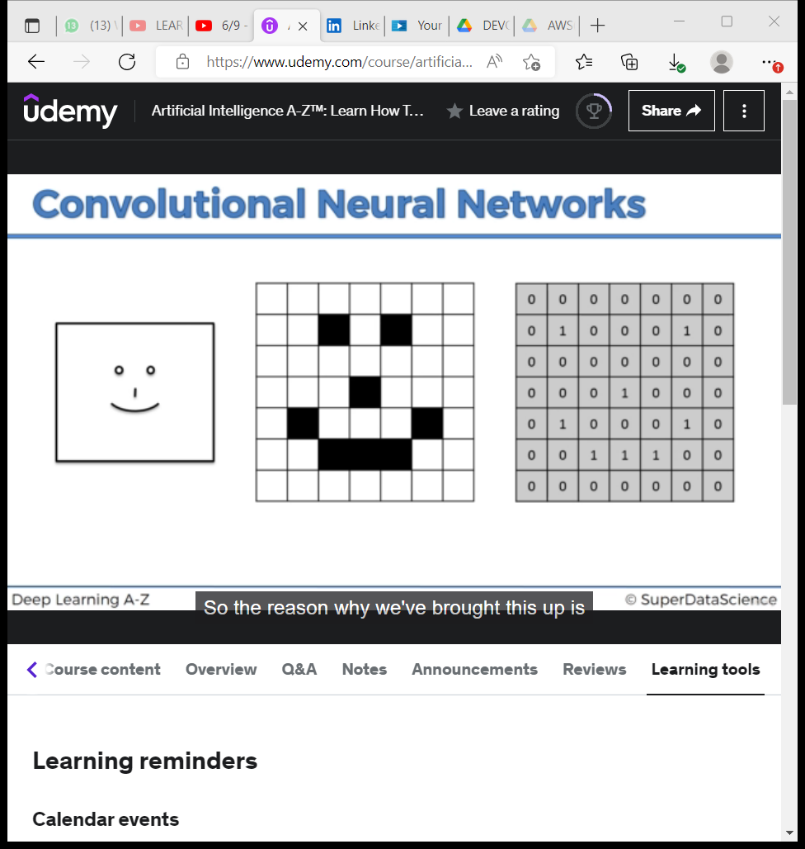

Slide 13
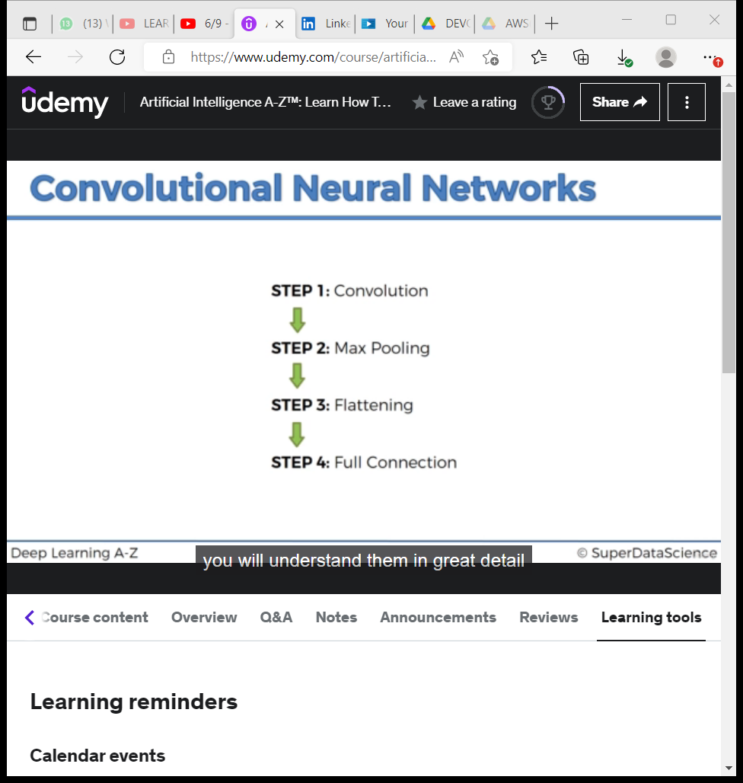

Slide 14
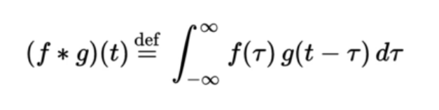
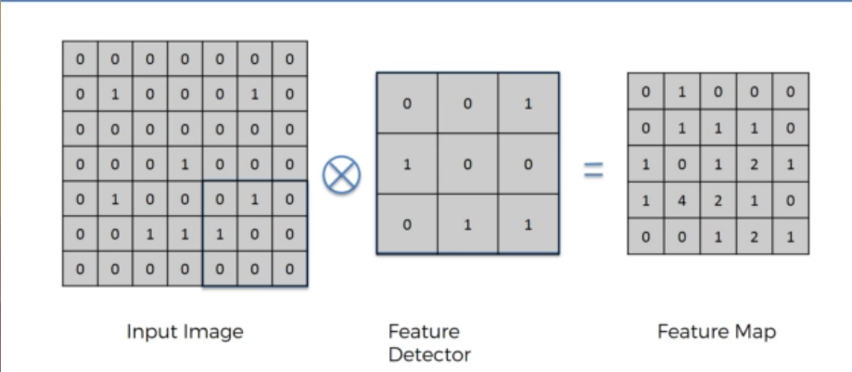
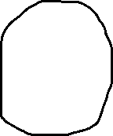
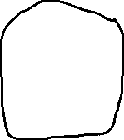
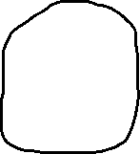
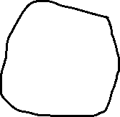
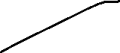
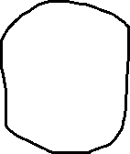
Step 1 : Convolution
No of matchings are updated
Kernel
Kernel

Slide 15
We have reduced the size of the image by doing convolution
We are losing some information when applying feature detector because we are having less values in our resulting matrix

Slide 16
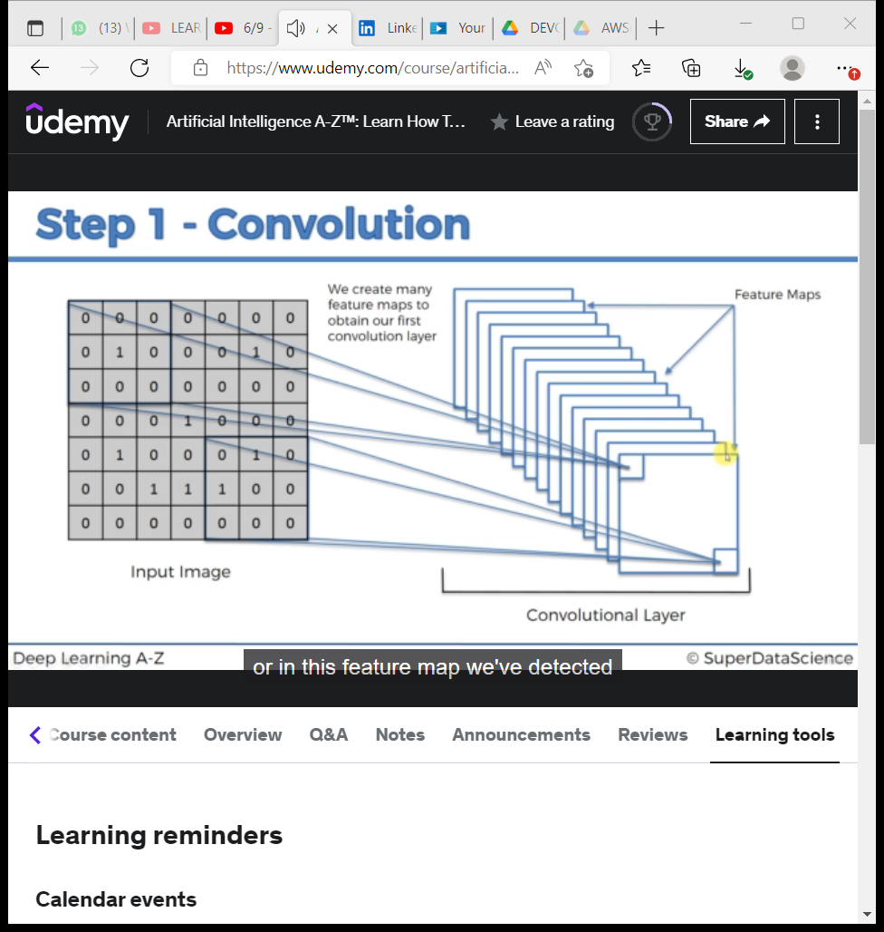

Slide 17
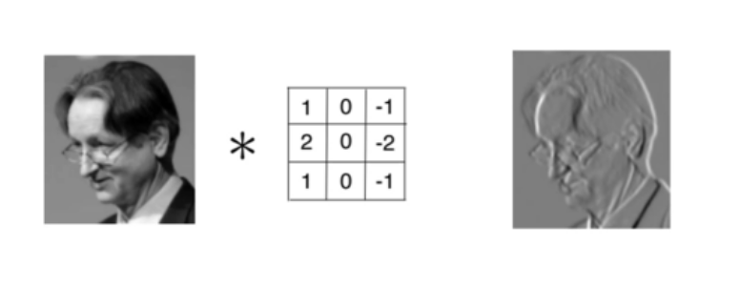
These feature maps includes gray image, edge detector image, blur image, emboss(3D) image…….
The primary function of convolution is to find features in the image using feature detector, put them into a feature map and by having them in a feature map, it still preserves the spatial relationships between pixels

Slide 18
Step 1 : b) : ReLU Layer (Rectified Linear unit)
We are applying rectifier because we want to increase non linearity in our image, rectifier acts as that function which breaks up linearity
We want to increase non linearity because images are highly non-linear
When we are applying mathematical operations such as convolution and running this feature detection to create our feature maps, we risk that we might create something linear and therefore we need to break up the linearity
Linearity -> white->gray->black and we are breaking this linearity
A non linear activation function is essential at the filter output of all intermediate layers

Slide 19
Step 2 : Max Pooling
Our Neural network has a property called spacial invariance, meaning that it doesn’t care where the features are allocated
Lets say a lion has a mane around its head and in different images we have different lions looking in diff directions, giving different poses, textures, lighting effect,………. Pooling means that it should be able to detect these manes no matter the position of the lion, distance , lighting, angle…….

Slide 20
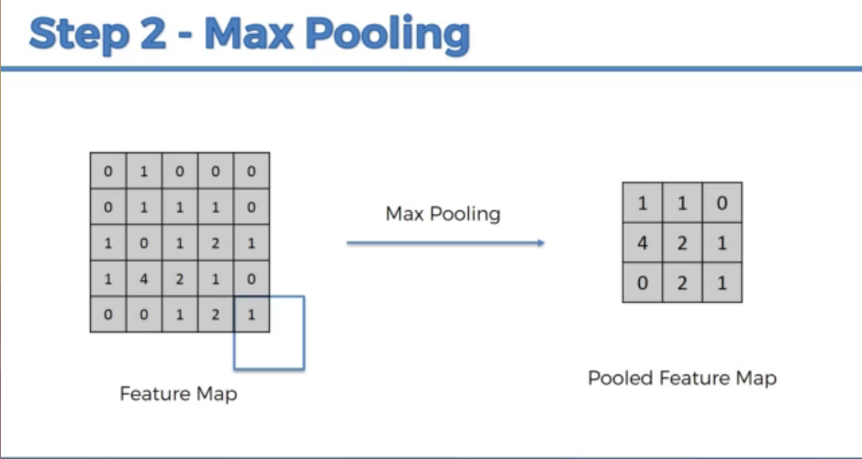
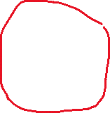
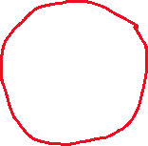
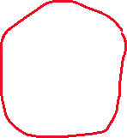
Max value is chosen from the matrix and entered in the pool featured map

Slide 21
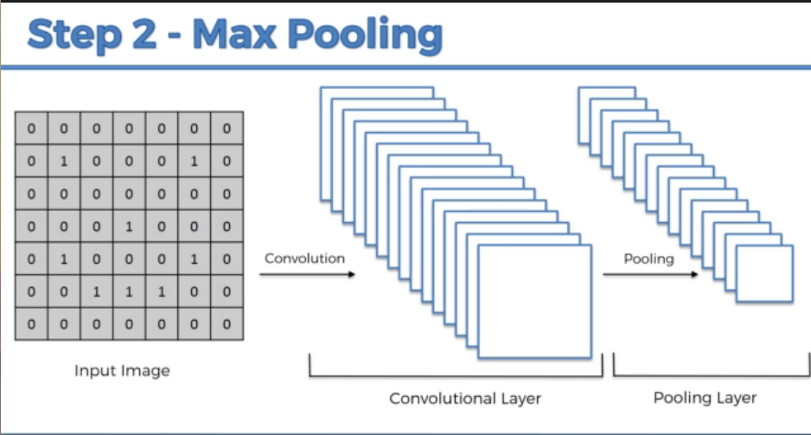
We are reducing the number of parameters that are going to go into our final layers of the neural network and therefore we are preventing overfitting.

Slide 22
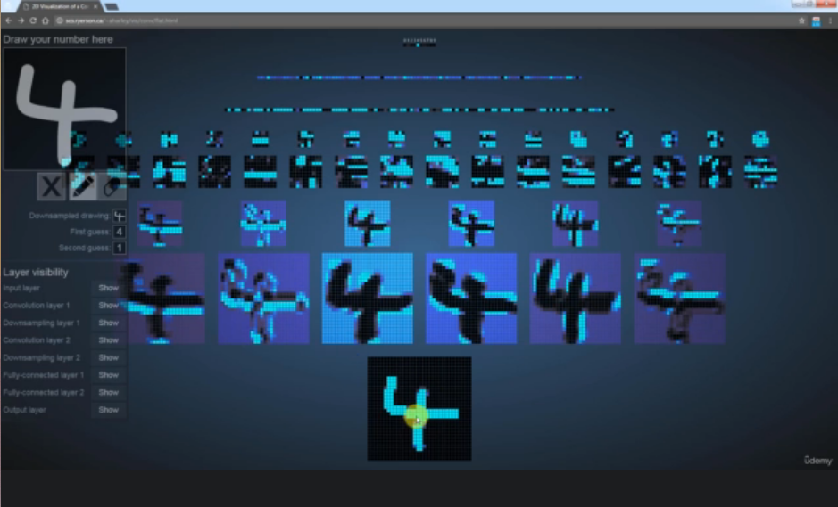
POOLING
CONVOLUTION

Slide 23
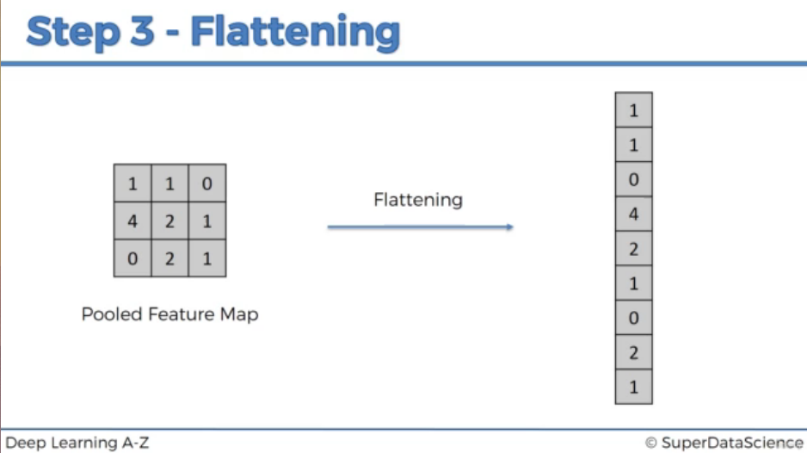
Step 3 : Flattening

Slide 24
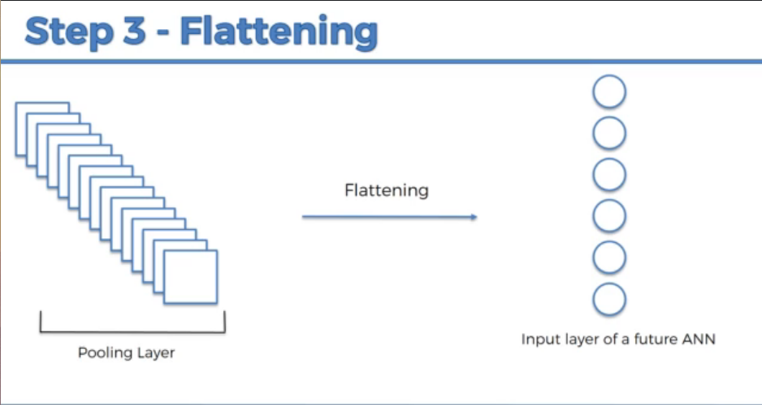

Slide 25
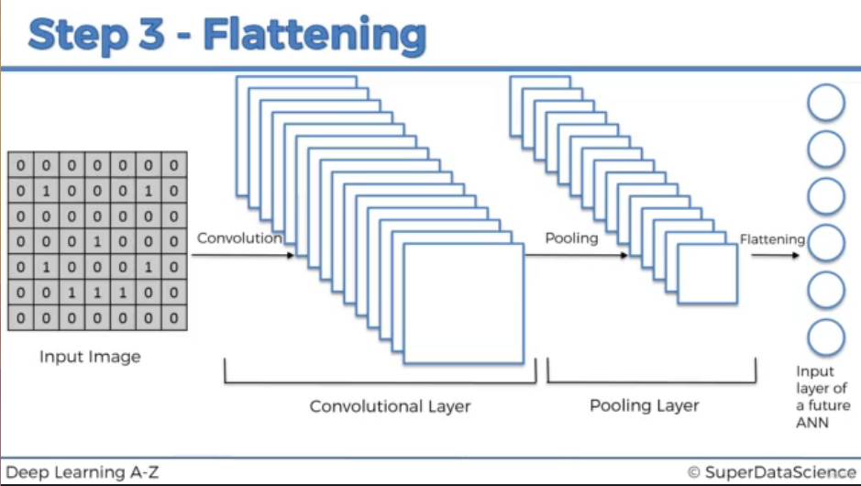

Slide 26
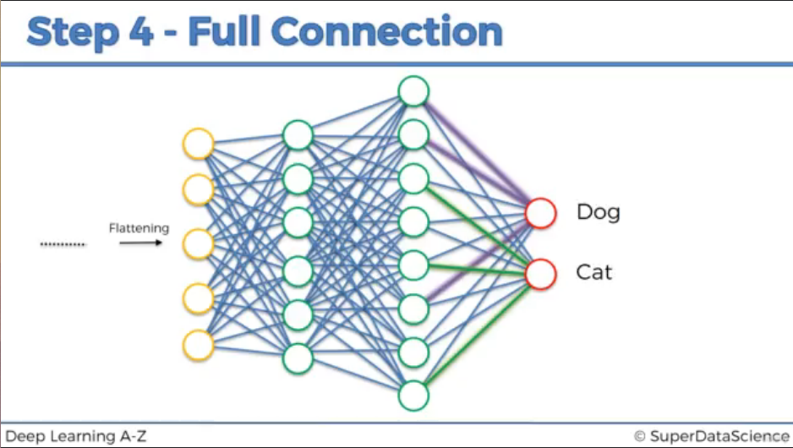
Step 4 : Full Connection

Slide 27
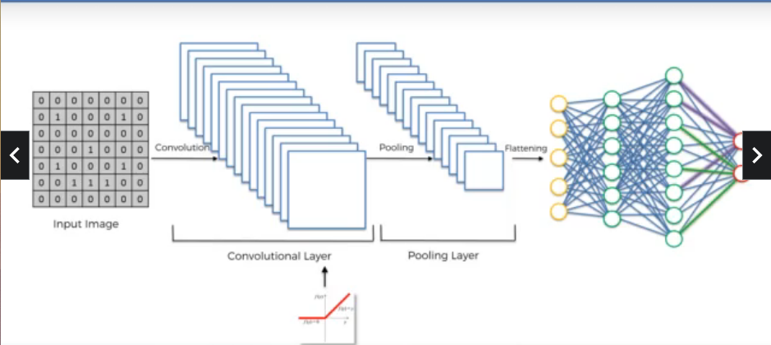
Summary

Slide 28
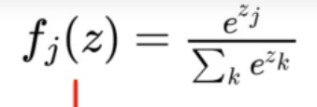
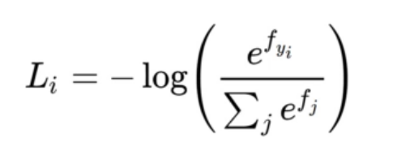
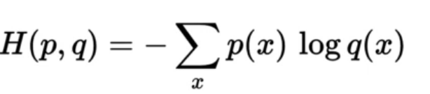
Softmax and Cross Entropy
The probability of all the outcomes when added up equals 1 but how does the node know the value of the other node’s output. Actually it don’t , we use a softmax function in order to help us out of this situation
> The above is the formula for softmax function
Softmax function comes hand in hand with the cross entropy function
The above is the formula for cross entropy function

Slide 29
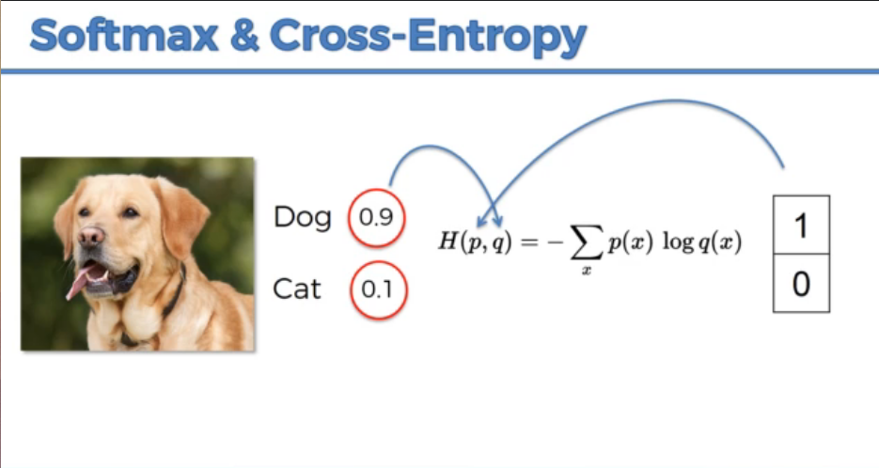
In CNN we can use cost function but a better option is cross entry function. Also called as the loss function. Loss function should be minimized in order to maximize the performance of our network

Slide 30
Why to use cross entropy instead of mean squared error
-> At the very start of our back propagation our output value is very tiny. So it is much smaller than the actual value we want. Our gradient descent will be very very low
-> When we use cross entropy it actually helps the network assess even a small error like that and do something about it
-> Example :
Lets say our 1st ans was 1/1million and in 2nd iteration our ans is 1/1000
If we calculate the mean squared error there is not much significant change
But If we calculated the cross error function there is a significant change
Cross entropy is preferred only for classification but for regression we go for mean squared error

Slide 31
Neural Networks
Linked in

Slide 32
Types of Learning
Supervised Learning
We have a small training set and then have the network find patterns
Then we use these patterns to run against test data
Unsupervised learning
We let the network find patterns in unlabeled data. Our network may find new clusters that we haven’t thought of. This works particularly well for larger data sets
Reinforcement Learning
Here the machine can run algorithms and then look at the results.
If the positive event occurs the machine can reinforce or learn the algorithm

Slide 33
Things to consider
1. We will need massive amounts of data
2. We will use an empirical approach
That means we will run small exp to try and fine tune our network to get better results
Modern neural networks give us plenty of opportunity to change our configurations
These are called our networks hyper parameters

Slide 34
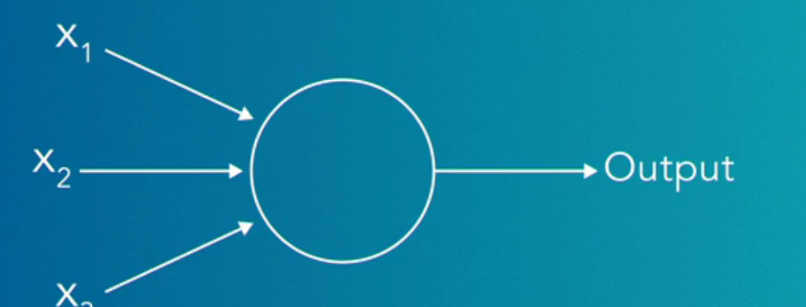

Perceptrons
The earliest form of networks were called perceptrons
Perceptrons have a binary output of 1 and 0
But since we will be adding weights to our inputs the output we will be getting in most of the cases will be greater than 0
So we will be using sigmoid neurons in place of perceptrons
Perceptron

Slide 35
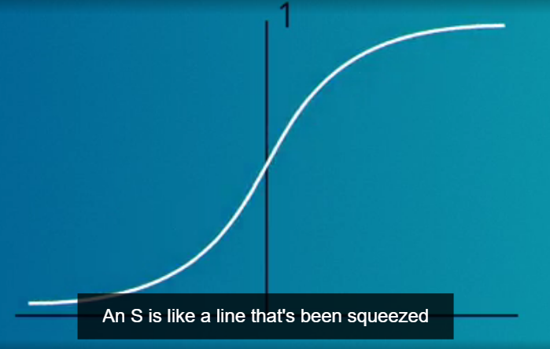
Sigmoid neuron
These neurons will hold a lot more info than the binary choice we get with perceptrons
In fact we can put any number we want into a sigmoid neuron. Then we will use a sigmoid function to squeeze that number between 0 and 1
- > Graph of sigmoid function

Slide 36
Bias
A number we put in with weight and input to encourage neurons to fire or stay silent
Bias is one of the neural networks hyper parameters
Lets say we got the output as 1.8
We told to add 5 to our output every time.
This 5 is bias
A plain neural network is also called a multi layer perceptron
All the neurons in our neural network has some activation level

Slide 37
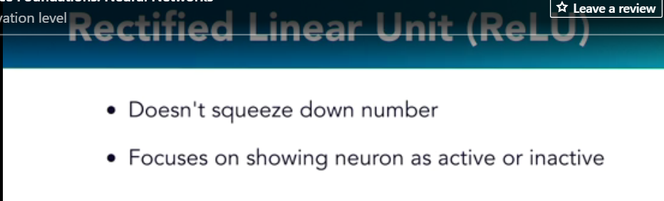
ReLU

Slide 38
Back propogation
Backpropogation is the way that the neural network tweaks each one of the weights to minimize the cost function
Labeled -> classifying data -> supervised learning
Unlabeled -> clustering data -> unsupervised learning

Slide 39
Deep Learning and Neural networks
Linked in

Slide 40
Intro
Neural networks with more than 3 hidden layers are called deep learning networks
Applications of DL:
NLP (unstructured dat)
Speech recognition and synthesis
Image recognition
Self driving cars
Customer experience, healthcare and robotics

Slide 41
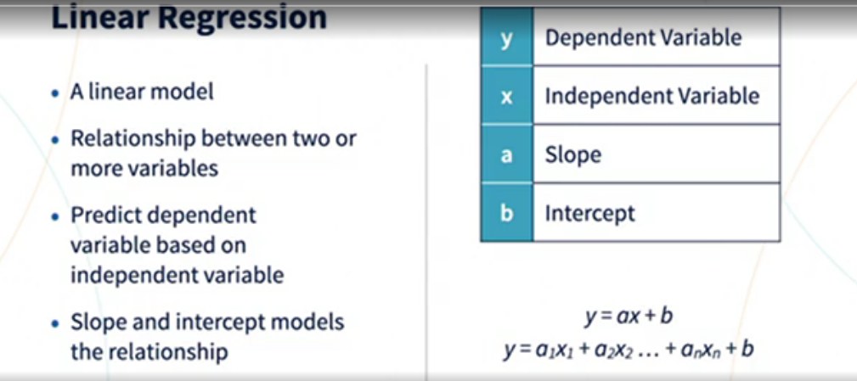
Linear Regression

Slide 42
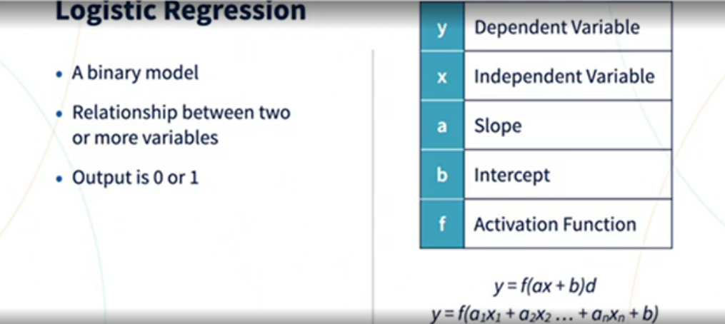
Logistic Regression

Slide 43
Deep learning is a complex and iterative process
Starts with random initialization and works towards the right values by trial and error

Slide 44
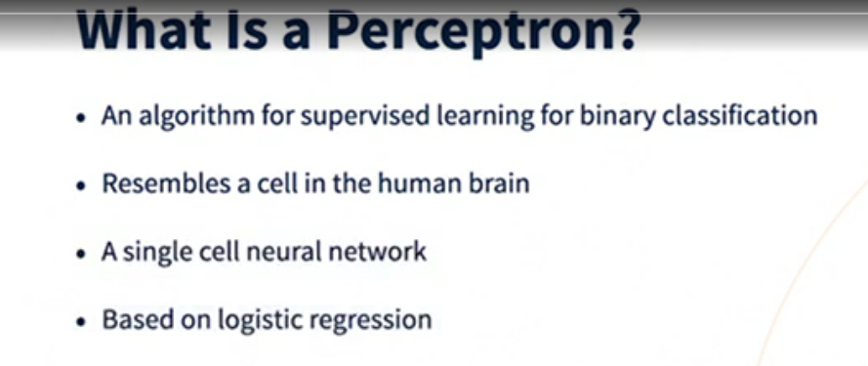
Perceptron

Slide 45
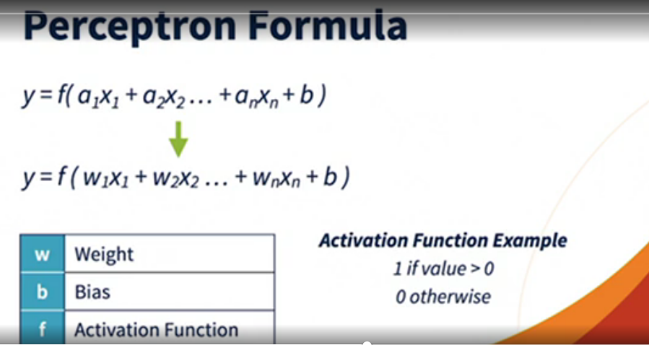
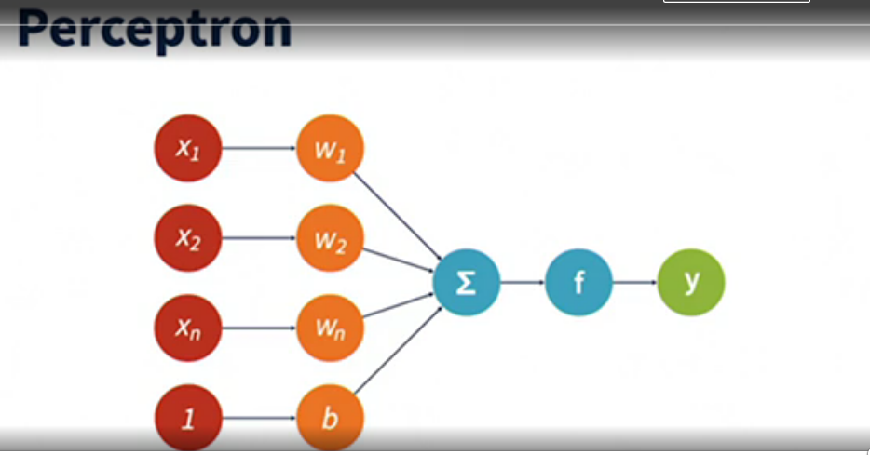

Slide 46
ANN
Perceptrons are called nodes in the network
Nodes are organized as layers
Each nodes has weights, biases and activation function
Each node is connected to all the nodes in the next layer
Softmax activation function is used in the output layer for classification problems

Slide 47
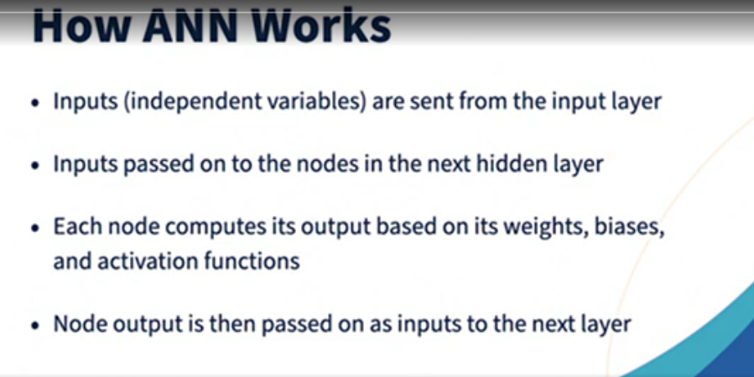
ANN working

Slide 48
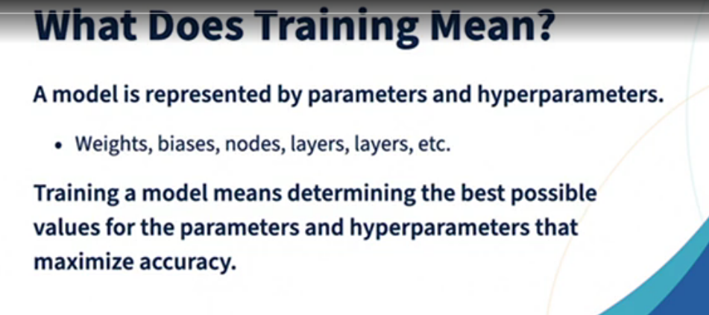

Slide 49
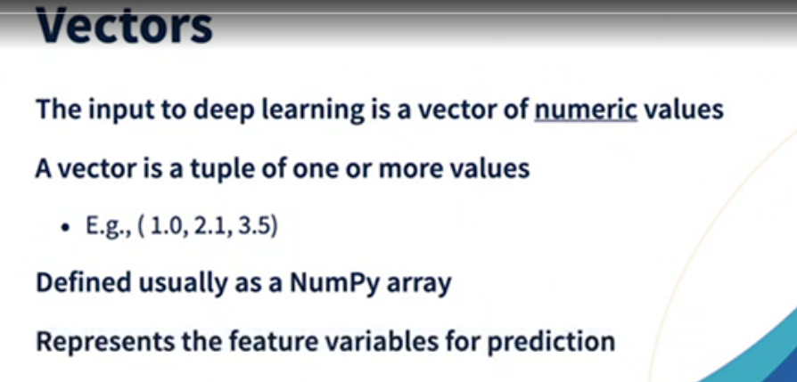
Vectors

Slide 50
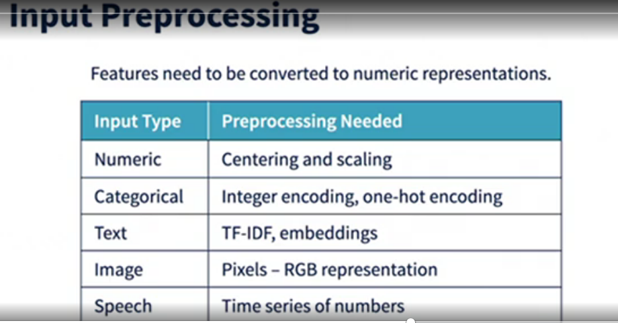
Input preprocessing

Slide 51
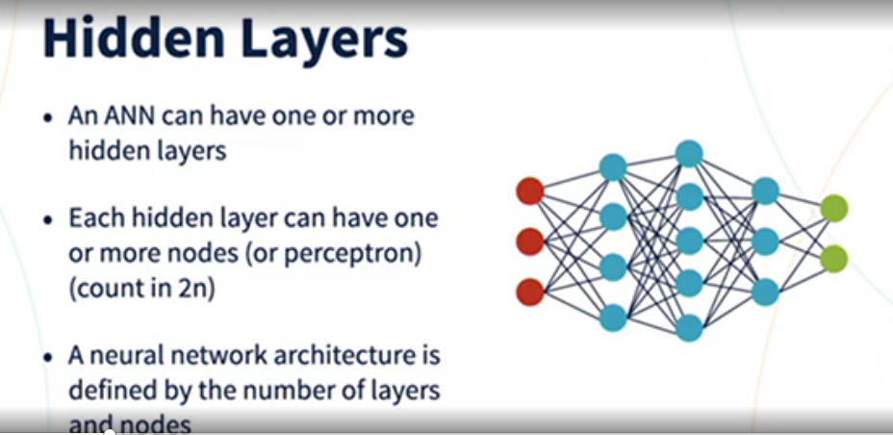
Hidden Layers

Slide 52
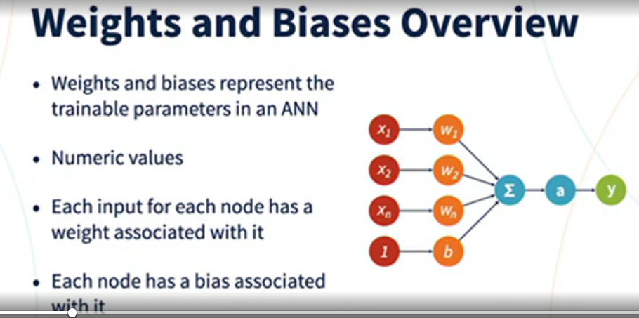
Weights and Biases Overview

Slide 53
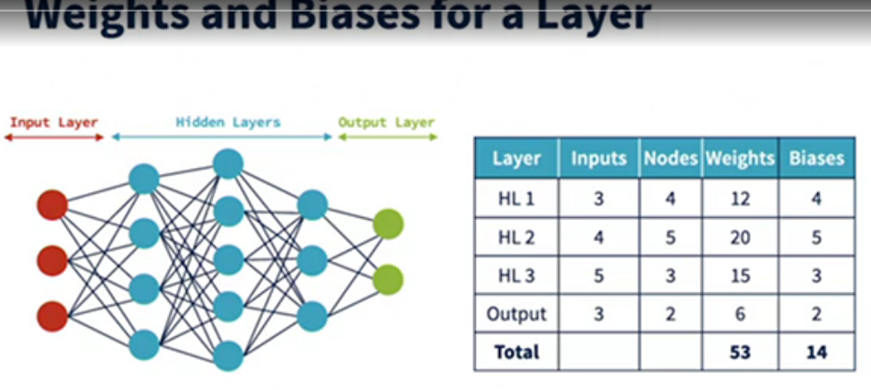
Weights and Biases for a layer

Slide 54
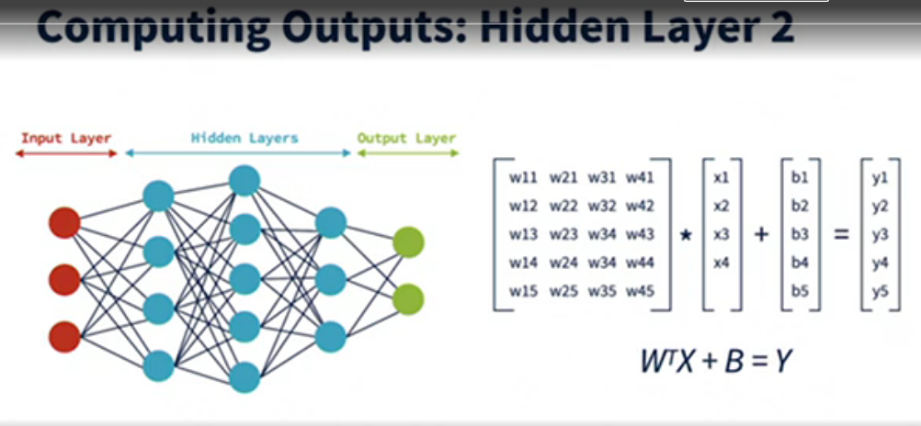

Slide 55


Slide 56


Slide 57


Slide 58


Slide 59

Splitting input

Slide 60

Model Architectures and Hyper Parameters

Slide 61

Weights Initialization

Slide 62


Slide 63


Slide 64



Slide 65


Back propagation

Slide 66

Gradient descent process

Slide 67


Batch

Slide 68


Epoch

Slide 69



Slide 70

ANN model

Slide 71
For every forward propagation step, there will be a corresponding backpropagation step in gradient descent
The purpose of back propagation is to adjust weights and biases on the estimated error

Slide 72

Optimizing for Inference

Slide 73

Optimizing for Training

Slide 74

Preparing for Tuning

Slide 75

Tuning Levers

Slide 76

Tuning Experiments

Slide 77


Slide 78

Batch Size

Slide 79

Epochs

Slide 80


